Slide 1
How to Use this Presentation:
Double-check each slide carefully to be sure that all points are applicable to your plans.
Copy and paste the slides into your open enrollment presentation.
To increase your enrollment rate, we recommend that you present these slides after you discuss your medical, vision and dental plans.
If a slide has a video on it, simply click the video to open it in your browser.

Slide 2
Dependent Care Account

Slide 3
What is a DCA?

Slide 4
Dependent Care Account
A dependent care account (DCA) makes daycare, nursery school, and elderly care more affordable by reducing your taxable income, saving you hundreds of dollars in tax savings each year.

Slide 5
Dependent Care Account
How much you can contribute:
What you can use it for:
$5,000 for married couple (filing jointly)
$5,000 for a single parent
$2,500 for a married person (filing separately)
Daycare or elder care
Before-school and after-school care
Preschool and nursery school
Private sitter
Summer day camp
Nanny service

Slide 6
Dependent Care Account
Ineligible Dependent Care Expenses
Per IRS publication 503, a DCA cannot be used for:
Tuition or school expenses for kindergarten and above, overnight camps, expenses for non-disabled children aged 13 and older, and day care expenses while you are not working.
You may not use DCA funds towards dependent day care expenses if your spouse or other dependent (e.g. an older sibling) is providing the care.

Slide 7
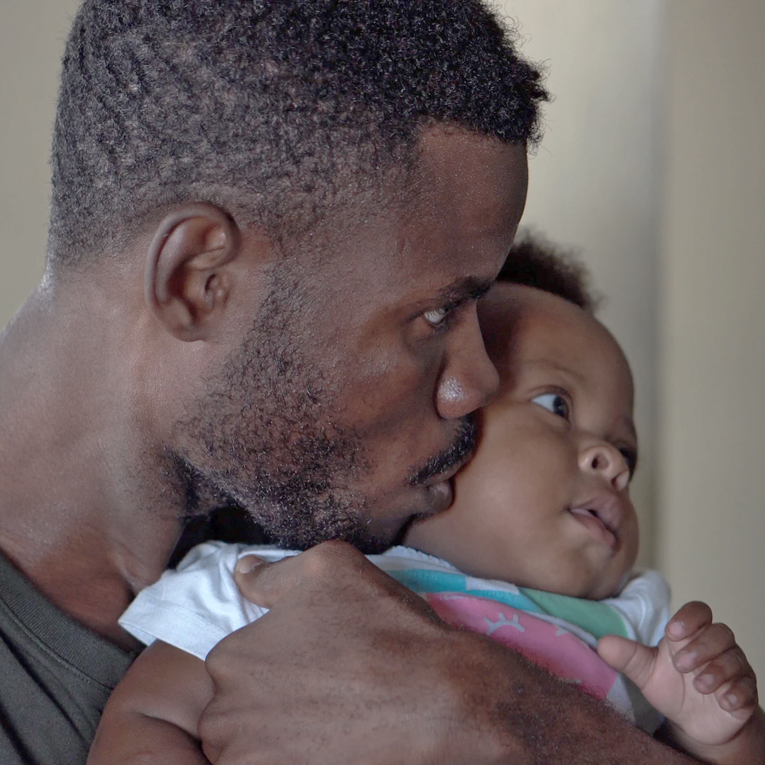
Dependent Care Account
Dependent Care Criteria:
You and your spouse must be employed or full-time students.
The amount to be reimbursed cannot be greater than your or your spouse’s income, whichever is less.
To receive reimbursement, you must have contributed the funds and incurred the expense.

Slide 8
Dependent Care Account
Dependent Care Criteria:
The child being cared for must be age 12 or under and a legal dependent under federal tax rules.
The day care services may be provided in your home or another location, but not by someone who is your minor child or dependent (for example, an older sibling).
If the services are provided by a day care facility that cares for six or more children simultaneously, it must comply with state and local day care regulations.
Services must be for the custodial care of the child.

Slide 9
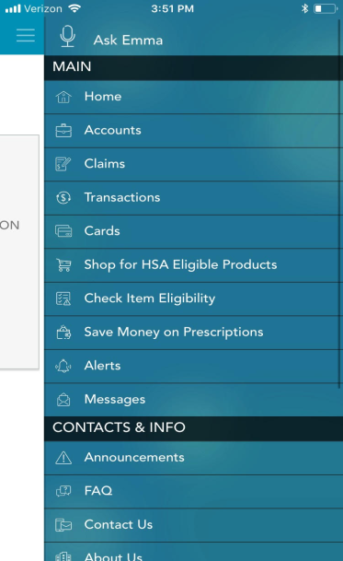
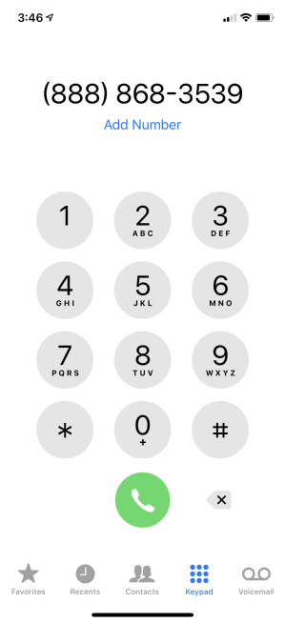
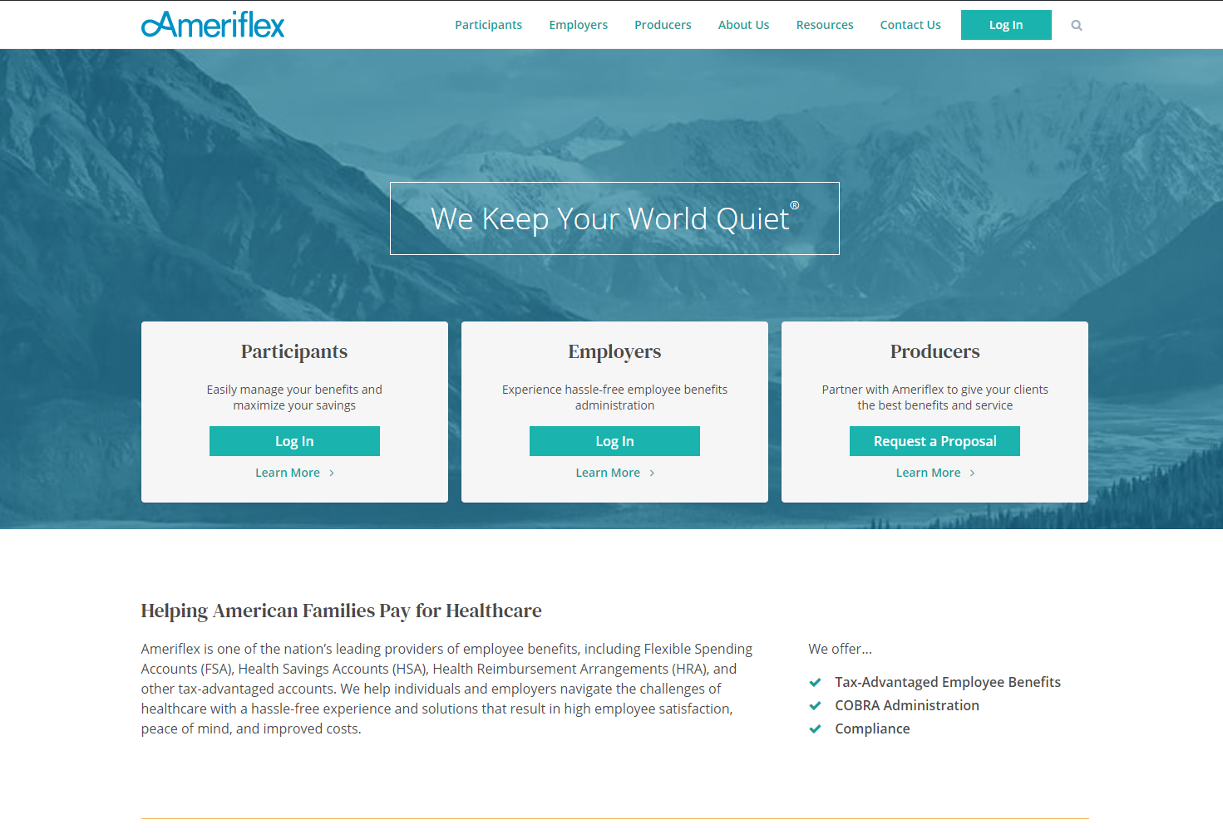
Ameriflex Support
Download the Mobile App
Call Us at
888.868.3539
Visit
www.myameriflex.com

Slide 10
Questions?

